Slide 1
Manage Software Development Risks
Problems worthy of attack
prove their worth by hitting back
Piet Hein
Notes:
Mostly from Chapter 5 Risk Management
How risky is software development? According to Capers Jones’ database, the odds of a large project finishing on time are close to zero. The odds of a large project being canceled are 50-50.

Slide 2
Risks
Risk: potential problem that could adversely impact
  planned schedule, budget, or success of the project
Not just something difficult
Should have some potential for occurrence
If it occurs, it will generally alter the normal plan
Notes:
A risk is a potential problem that could adversely impact the planned schedule, budget, or success of the project. Note that this means that the risk is not accounted for in the normal plan!
The fact that something is difficult does not constitute a risk! If it is difficult, the normal plan should account for this.
A legitimate risk should have some reasonable potential for occurrence.
If the risk does occur, it will generally result in an alteration of the normal plan.

Slide 3
Risk Management
Risks must be identified and then managed:
  preventing the risk occurrence
    selecting hardware that is available from multiple sources.
  monitoring the risk
    auditing the progress of contractors on whom you have a dependency.
  taking corrective action
    use a simulator until the hardware is ready, or hire consultants to make up for your staff shortfall.

Slide 4
Risk - Peter Drucker, Management Consultant
Existing means of production will yield greater economic performance only through greater risk
Futile to try to eliminate risk, and questionable to try to minimize it, but the risks taken must be the right risks...
Choose rationally, rather than plunging into uncertainty on the basis of hunch, hearsay, or incomplete experience

Slide 5
Being Responsible for Risk
Can act early on if willing to accept risk of mistakes
100% safe conclusions => no action
Concentrate on controlling risk, rather than eliminating it
Inform others of level of risk taken
  Colleagues
  Clients

Slide 6
Elements of Risk Management
Risk Assessment
  risk identification
  risk analysis
  risk prioritization
Risk Control
  risk-management planning
  risk resolution
  risk monitoring

Slide 7
Assess Project Risks
Given a project case study, the learner will assess the project risks
  correctly identifying a set of risks
  analyzing the risks for likelihood and impact
  prioritizing the risks by impact

Slide 8
Risk Identification
Identify factors that pose a risk
Common risks
  making one of the “Classic Mistakes”
  ignoring development basics
  failing to manage risks
Chapter 5 has a list of schedule risks
  good to review them against any project

Slide 9
Most Common Schedule Risks
Feature creep
Requirements or developer gold plating
Shortchanged quality
Overly optimistic schedules
Inadequate design
Silver-bullet syndrome
Research-oriented development
Weak personnel
Notes:
Top 10 also lists contractor failure and friction between developers/customers

Slide 10
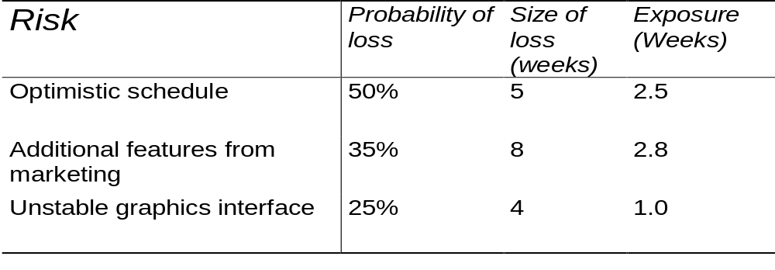
Risk Analysis
Analyze each risk for impact
  risk exposure is probability of loss times size of loss = expected loss
  Works for both schedule (weeks) and cost ($)
Notes:
Discuss how to estimate size of loss and probability of loss
Probability: estimate + review; Delphi or group consensus; betting analogies refined to be happy to take either side (100:125 is 100/225 = 44%); adjective calibration (highly likely, very good chance, probable, likely, improbable, unlikely, highly unlikely)
Note that total expected overrun is sum of exposures, if they are independent!!

Slide 11
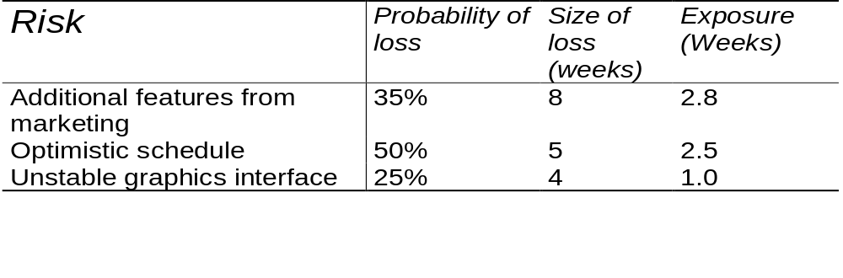
Risk Prioritization
Which risks to attend to?
  80% of time fixing 20% of problems
  fix the right ones!
Sort by exposure
Notes:
Here we would deal with the top two and ignore the bottom ones. If we could fix the top two, we save 5.3 weeks

Slide 12
Software Import Risk Example
European computer manufacturer moving to UNIX/C
Decision handed down by lab director to import basic package from California
Quality requirements for development very high
  Zero defects to customers
  Two minutes downtime per 48 hours (HW / SW)
Imported component more than half of total
UNIX vendor had no specs on quality flowed down
Notes:
99.93% availability
UNIX has well published problems in reliability, so investigation is clearly warranted
No one felt that quality requirements could be laid on the vendor (especially now)
Tacit assumption initially that quality was good
1. may be OK for most users
2. If your requirements are atypical, watch out

Slide 13
Example Risk Analysis
Probability that the product will ever meet quality specifications
Probability of severe delay trying to meet minimal quality requirements
Probability competitor will handle more intelligently
Probability director will blame software team
What should software team do?
Notes:
Management was lab director who violated company policy in failing to specify quality of UNIX package

Slide 14
Control Project Risks
Given a project and a risk assessment, the learner will control the project risks by
  preparing a risk-management plan
  resolving sample risks
  monitoring the results

Slide 15
Create the Motivation for Getting Control
Motivation has strong influence on results
Reward positive performance
Create consistent reinforcement
Create atmosphere that allows realistic commitments
Uncertainty motivation principle
  Uncertainty is half technical and half motivational, but with good enough motivation, uncertainty won't lead to problems
Notes:
Application product subsidiary of a computer manufacture. Development team would plan on weekly incremental delivery of 'something working.' If they had it demonstrable by Thursday, they could use Friday for nonproject professional purposes. Such as attending lectures, research projects, writing technical papers, reading technical literature.
Group free to make own plan, oriented toward visible means of progress weekly. Felt more would get done in 4 focused days than 5 without result focus. Much iteration on plans until got realistic ones.
Good overall results

Slide 16
Risk Management Planning
Go through each risk identified
  how can the risk be prevented?
  how will the risk be monitored?
  how will the risk be resolved if it occurs?
How will new risks be identified?
All of the above documented in a risk management plan

Slide 17
Risk Resolution
Depends on specific risk - see text for ideas
  avoid the risk
  move the risk off the critical path
  invest in finding out more about the risk
  eliminate the root cause
  build the risk damage into the schedule
  publicize the risk
  control the risk
  remember the risk on later projects
Notes:
table in text p 98 gives ideas for controlling specific risks - discuss

Slide 18
Risk Monitoring
Keep top-10 risks list
Review every week
include risk resolution progress for each
Risks that are watched are easier to manage
Notes:
With two or three high risk areas even your best schedule projections will be meaningless
If commit to ambitious schedule know how you will handle the risks - if not you are gambling
See case study on p 103

